Slide 1


A Study of Coffee Production
Connery Hinson
Paul Anderson
Colin Roberts
Mitchell Hatch
Padmashri Bhatta

Slide 2
Executive Summary
As coffee is a popular and widely consumed beverage around the world, its interesting to explore the production of coffee in various countries and continents. The project will make use of bar and scatter plots to visualize the data and help with the interpretation of the findings. The analysis will cover different aspects of coffee production, such as the quantity produced, the quality of the coffee produced, and coffee cultivation methods, among others. An organization looking to start a coffee company might need data on where to market and where to grow coffee. To that end, we are attempting to use different data sets to analyze where the best location would be to grow for the highest quality coffee bean, and where people consume coffee. We pulled data from various data sets to compare the quality, weather and production levels of various locations around the globe. We compared quality, consumption, production and weather to see what makes the best (and most) coffee beans possible.

Slide 3
What questions need to be answered?
In our analysis, we attempted to answer the following questions :
· What countries and continents consistently produce the highest quality coffee?
· Does weather, especially rainfall, affect the amount or quality of coffee produced?
· What countries consume the most coffee? Does the amount of coffee produced influence consumption?
· What countries produce the most coffee and does that affect the quality of coffee produced?

Slide 4
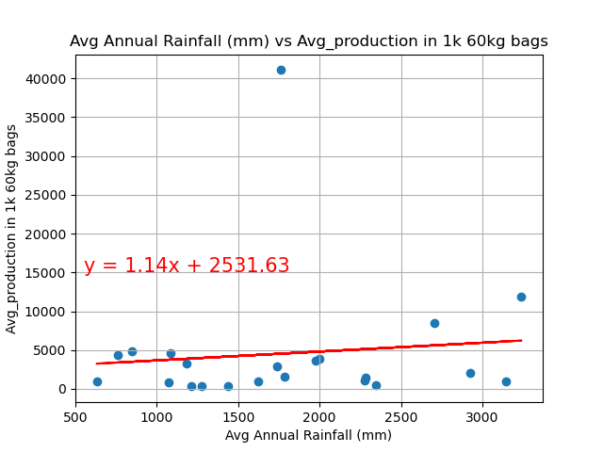
Avg rainfall vs production
Comments on the avg rainfall vs avg production analysis : In comparing avg rainfall to avg production amounts, we have a null hypothesis that says the amount of rainfall doesn't matter when it comes to amount of coffee produced. The p value is 0.148, so we cannot reject this null hypothesis. The massive production of Brazil with a rainfall amount that falls in the middle of these regions might distort the data. It appears, though, that rainfall amounts do not necessarily affect this metric.

Slide 5
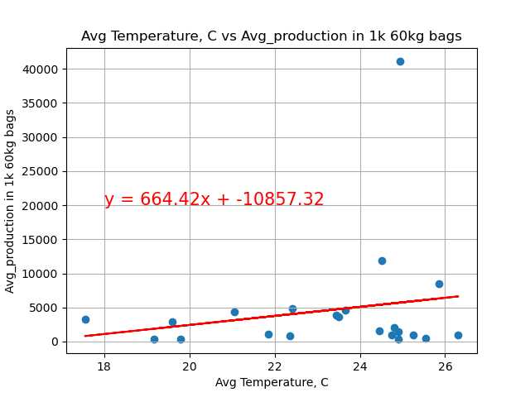
Avg Temp vs Avg production
Comments on the avg temperature vs avg production amount analysis: The null hypothesis here is that amount of coffee production would be about the same across temperatures. The p value is 0.022, however, and well below the 0.05 threshold. We can reject the null hypothesis. Coffee production appears to rise as temperatures rise, though we did observe that the reverse is true of quality. Brazil, with a high avg temperature, potentially distorts the data somewhat, but even with smaller coffee producing countries, the trend seems to hold. Our alternative hypothesis that avg temperature does affect production is likely true.

Slide 6
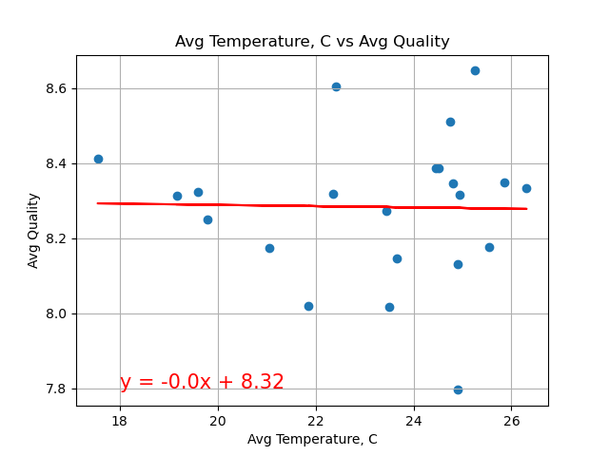
Avg Temp vs Avg Quality
# Comments on the Avg temperature vs Avg Quality analysis : Here, the null hypothesis again is that temperature has nothing to do bean quality. The p value is tiny, though, well below the 0.05 threshold. We can therefore reject the null hypothesis. Again, most coffee producing countries are in tropical or subtropical climates, but the variance in temperature within these regions affects quality. The correlation is negative, with quality trending downward as temperatures go up, and this is our alternative hypothesis, which has a very high likelihood of being true.

Slide 7
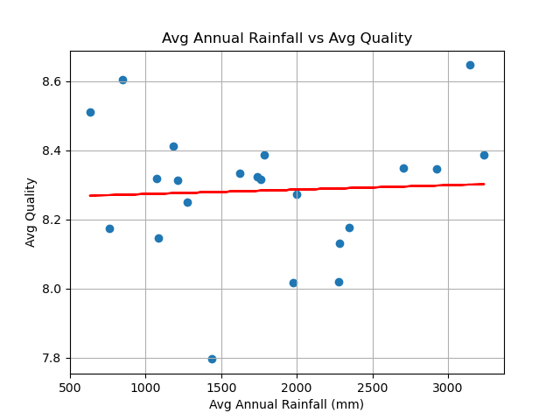
Quality vs Avg Rainfall
Comments on Avg Annual Rainfall vs quality of coffee : Here, the null hypothesis is that coffee quality and avg rainfall among the coffee producing countries have nothing to do with one another. The p value turns out to be about 0.15, so we cannot reject this null hypothesis. Most coffee producing regions do get significant rainfall, but the variance within this group of coffee producing nations does not appear to significantly affect the quality of coffee produced.

Slide 8
Answer: Does weather, especially rainfall, affect the amount or quality of coffee produced?
In asking the question about how much and weather, we discovered that some factors seemed to matter more than others.
In terms of production, it looks like rainfall did not matter how much coffee was produced, at least among these coffee producing nations. However, the quantity of production rose as temperatures rose, as indicated by the p values for each figure.
In terms of quality of the coffee, we found a correlation for temperature, with quality trending downward as temperatures rose. However, rainfall amounts within this subset did not appear to affect quality. The so-called ‘perfect’ average temperature to grow the best beans appears to be around 18 Celsius, or 65 Fahrenheit.
There are some limitations of the data we used. First of all, all of the top coffee producing countries are in tropical or subtropical climates, so the temperature and rainfall variations studied were within a fairly narrow range. Whether or not coffee could be reliably produced in colder or drier climes these countries is beyond the scope of these data. Also, the country of Brazil dwarfs the production of most other countries, and produces quite high quality beans as well, so their production alone has an outsized influence on the analysis.

Slide 9
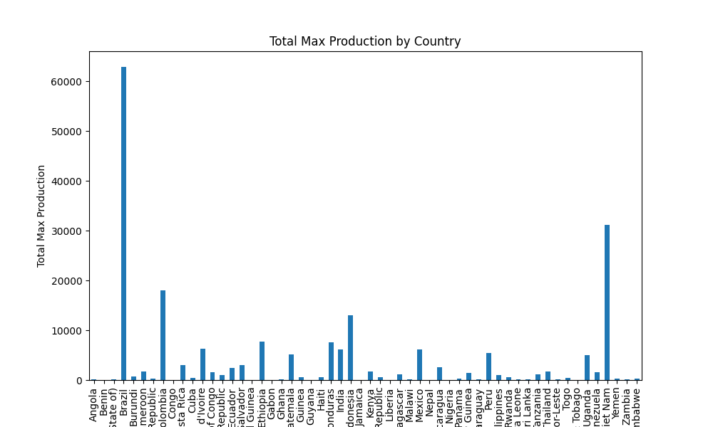

Slide 10
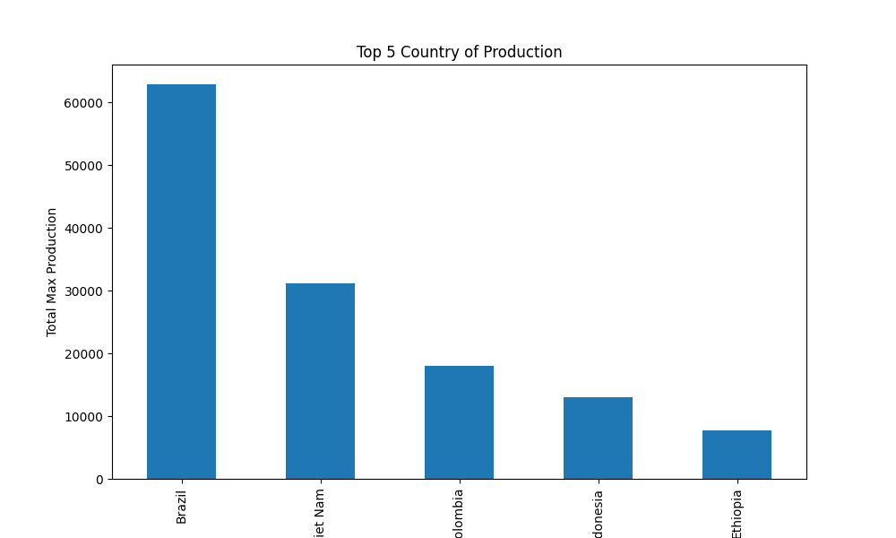
Top 5 Countries of Production
Brazil comes in first place with the most coffee production.
Almost out producing the next four top countries combined

Slide 11
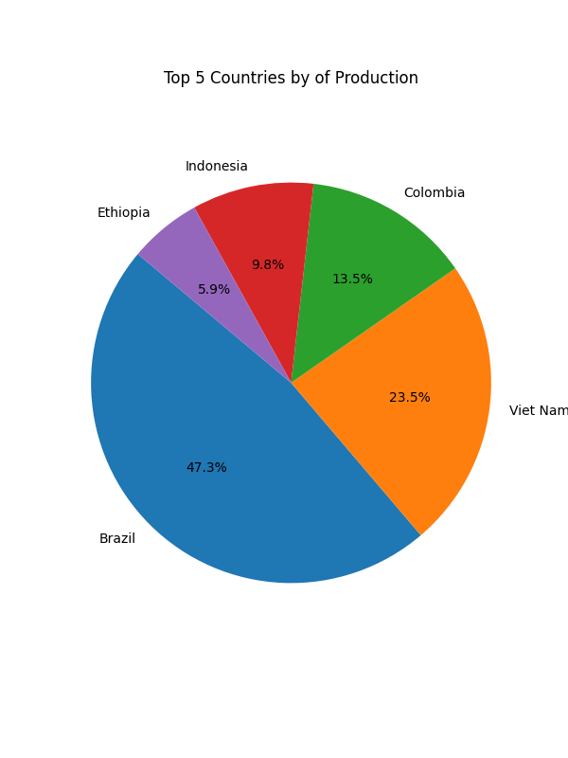
Top 5 Countries of Production
Brazil creating almost 50 % of the top 5 countries combined

Slide 12
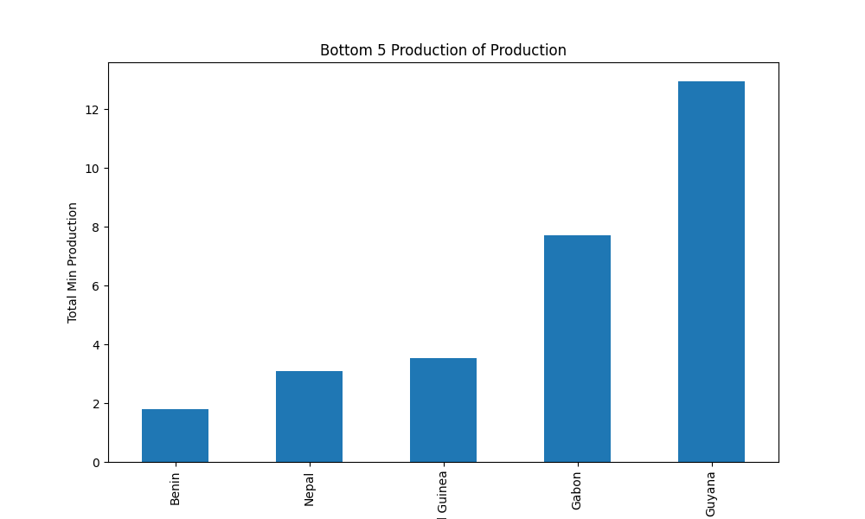
Smallest Amount of Coffee Production
Benin coming in last place of production making coffee coming from that country extremely rare

Slide 13
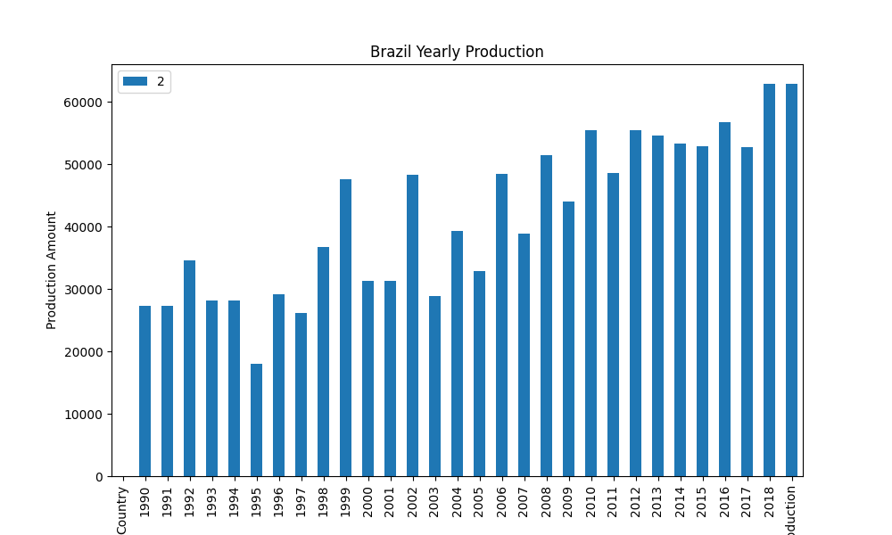
Brazil Yearly Production
The of the amount of coffee Brazil has produced since 1990 with a staggering upwards trend

Slide 14
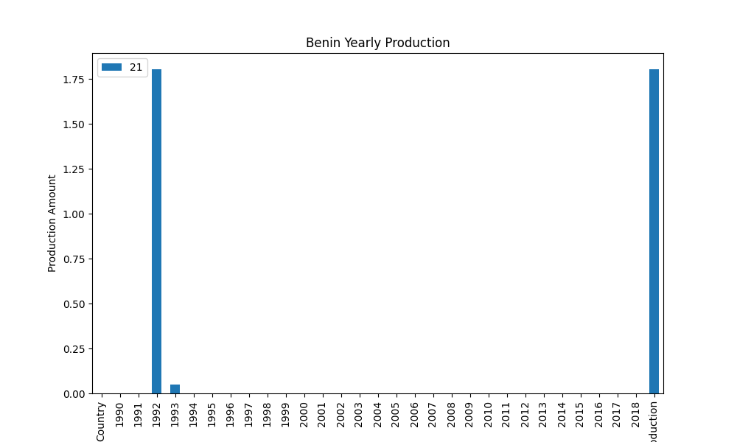
Benin Yearly Production
Showing Benin producing for only a single year in comparison.

Slide 15
Production Comparison
Benin
Brazil

Slide 16

What countries produce the most coffee and does that affect the quality of coffee produced?
After collaborating with Mitch and Paul on the Max Production data frames we merged a data frame that contained multiple columns for the score ranking different coffee from different countries. They were all calculated out (1 of 10) with a float type value. Score consists of Aroma plus flavor minus aftertaste plus body plus average balance plus uniformity plus clean cup plus sweetness minus acidity minus quakers.
.

Slide 17
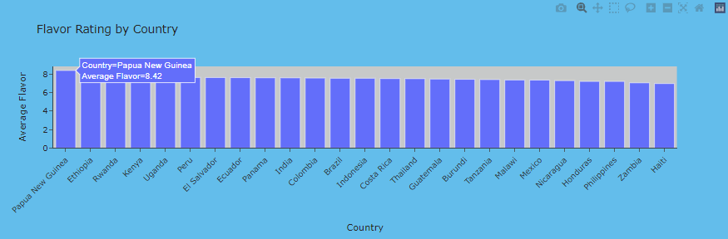
Flavor Rating by Country
An example of a column “Flavor” this demonstrates that all of the countries are closely aligned with the same Score for flavor.
.

Slide 18
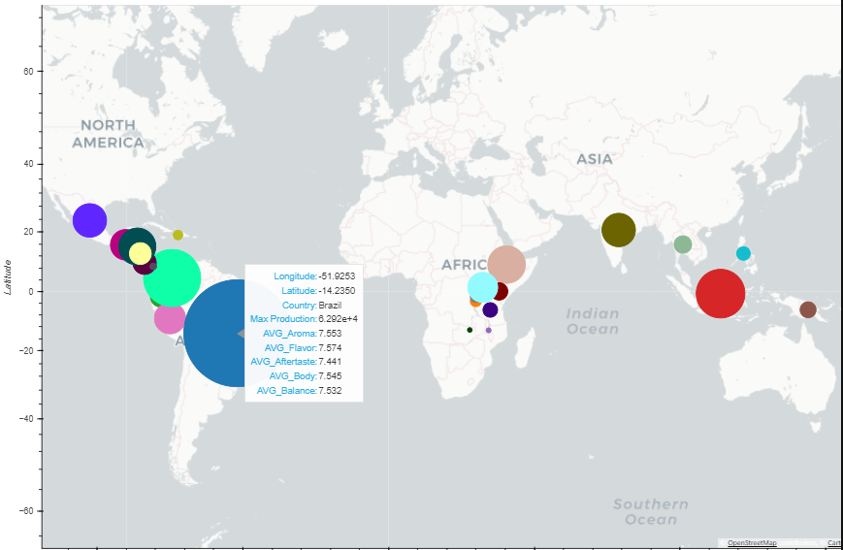
Map of Amount Produced by Country
This map displays that countries like Brazil have a much larger production rate than other countries like Haiti, Panama or Malawi. It is not even close.

Slide 19
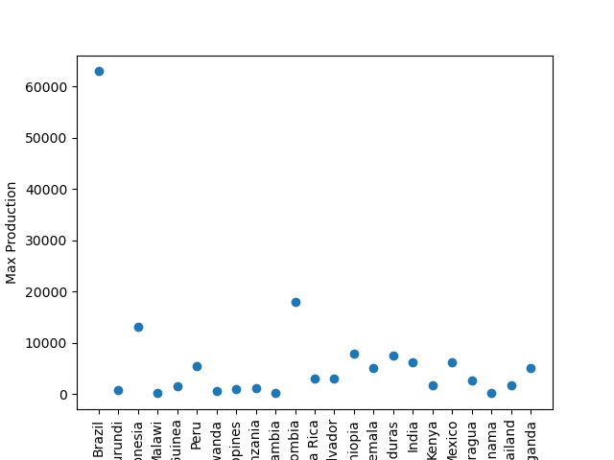
Scatter Plot Amount Produced by Country
This plot exhibits Max Production in a different light than previous in such that we drill down to see who is second and third and exactly how far Brazil is from the rest of the Countries, Indonesia and Columbia following but leading the rest.

Slide 20
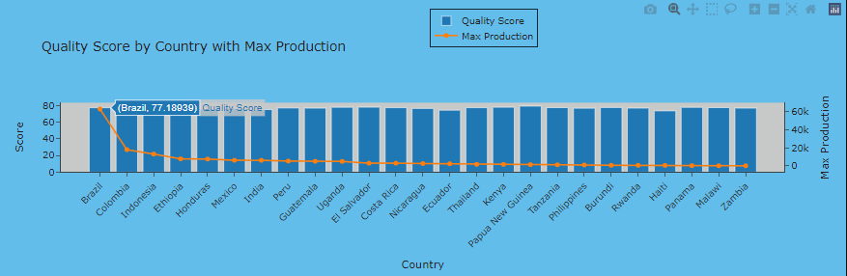
Bar Chart of Quality Score with trend line of Amount Produced
This bar chart with a trend line demonstrates the answer to the question. Brazil Columbia and Indonesia top three producers with Malawi, Haiti, and Panama bottom three. That said the bars behind the trendline show that there really is no difference between Countries when it comes to Score for Quality.

Slide 21
Answer to question: What countries produce the most coffee and does that affect the quality of coffee produced?
No, it does not. What countries produce the most coffee and does NOT impact the quality of coffee produced. All of the scores are so closely related it does not appear to influence the quality even where there is a lot more of production of coffee like Brazil, they are still neck and neck with Panama, Haiti, Malawi who have barely any production of coffee in comparison.

Slide 22
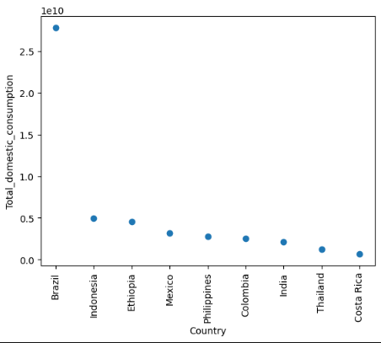
Question: What countries consume the most coffee? Does the amount of coffee produced influence consumption?
This plot shows consumption right aligned with production with Brazil leading the way just as in the max production data.

Slide 23
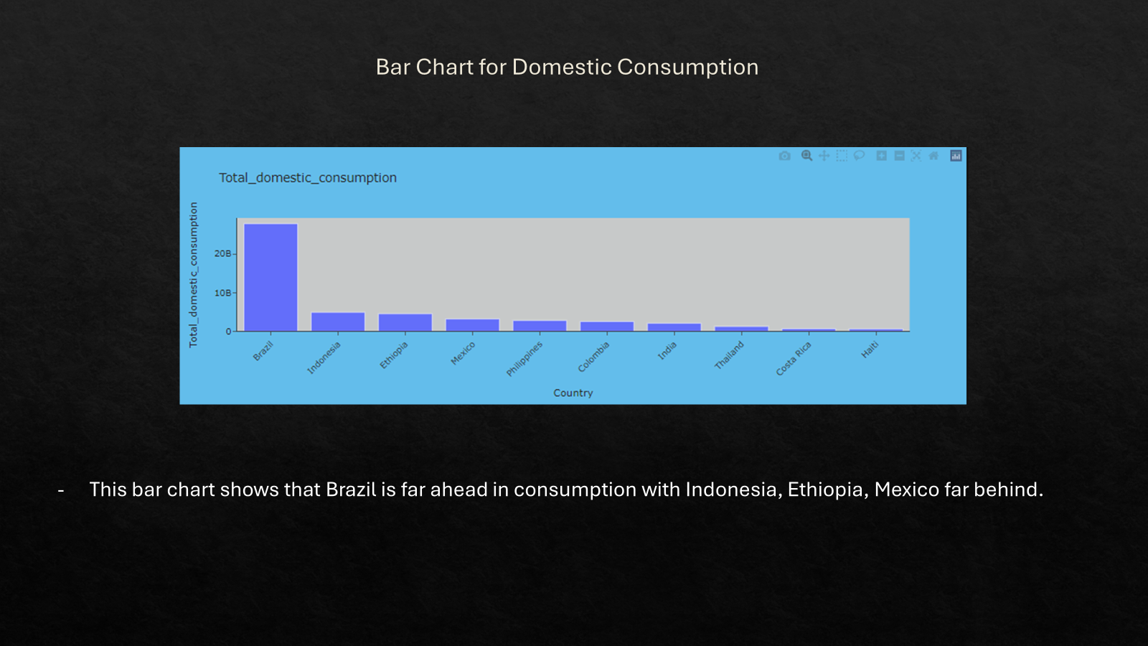

Slide 24
Answer: What countries consume the most coffee? Does the amount of coffee that is produced influence consumption?
The findings prove that production and consumption go hand in hand. Brazil producing the most coffee and in turn consuming the most coffee. Country for Country the data demonstrated that the more a country produced the more it consumed. Primary examples include Brazil, Indonesia, Mexico and Columbia.

Slide 25
Conclusions
Moderate rainfall is required for adequate coffee production. The top producing countries also exist in a subtropical or tropical climate where warmth and rain are both plentiful.
Quantity of Production rises as temperatures rise, even within the subset of these high producing countries, but higher temperatures can adversely affect the quality of coffee beans
The optimal temperature appears to be around 65 degrees Fahrenheit/18 Celsius. Below that temperature production tends to trend down. Above that point quantity continues to rise, but we start to see less quality.
We did observe that production and consumption tended to go hand in hand. Brazil, for example, produces by far the most coffee, and they also consume the most. Country for country the data demonstrated that the more a country produces the more it consumes. In addition to Brazil, Indonesia, Mexico and Columbia provide proof of this.
The amount of coffee produced does not seem to affect its quality. The data from Brazil, again, shows the way here. They produce great quantities of high quality coffee.

